Slide 1
Data Visualization Project
Exploration of four pollutants: NO, SO₂, CO, O₃
Jian Zou, Xinyan Zheng, Yue Pan, Jingxuan He, Manqi Cai

Slide 2
Presentation Overview
1
4
Overview
Discussion
2
5
Time Aspect
Questions
3
Location Aspect

Slide 3
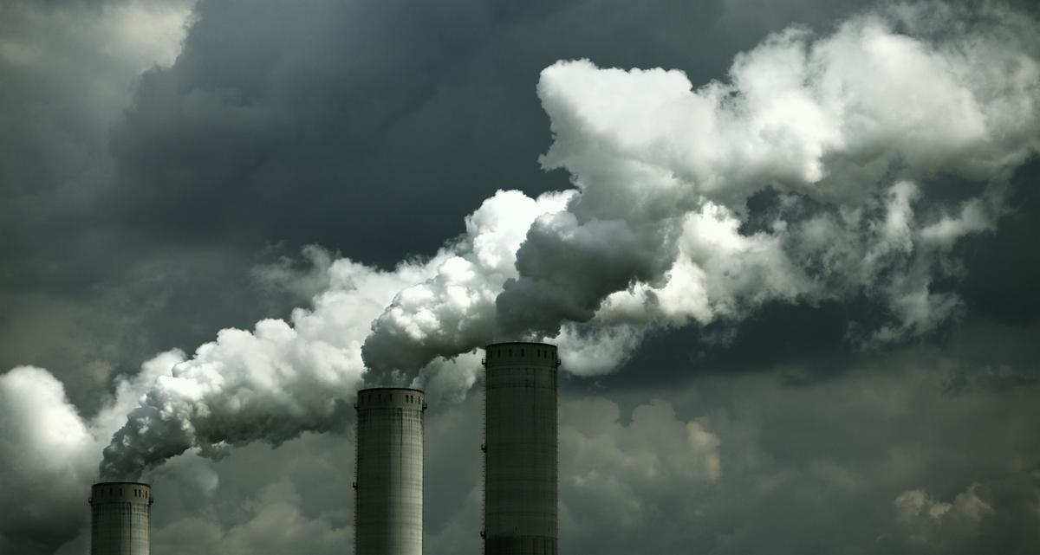
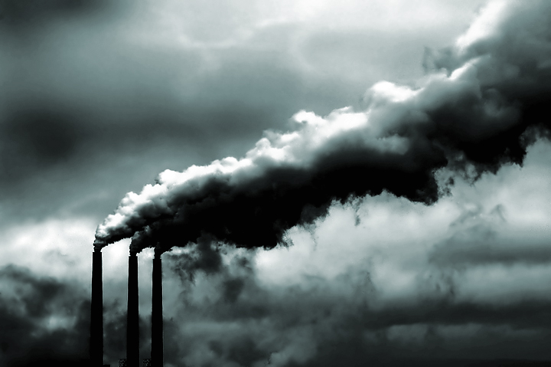
Data Description
6 years, 4 major pollutants : NO₂, SO₂, CO, O₃
Dimensions : 118079 observations, 24 variables
Variables: state code, county code, site num, address, state, county, city, date; Mean, Air Quality Index (AQI), max-value, max-hour of 4 pollutants
Here we visualized the data on the scale of time and location. Max and mean values for 4 pollutants were not used because the related information were included in other variables such as max hour and AQI.
Notes:
The data is collected by observing the concentration of four pollutants over six years in US and Mexico.

Slide 4
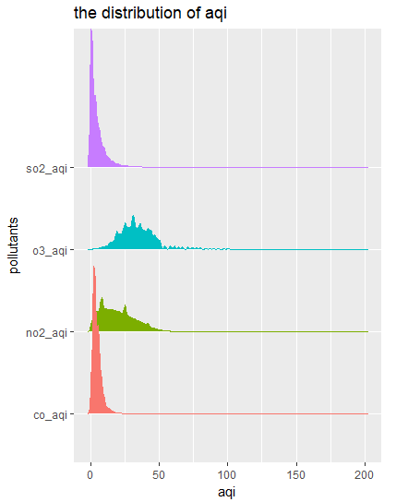
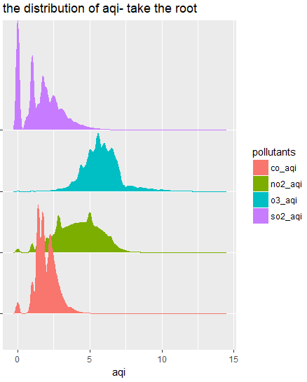
Check Distribution
Notes:
First we plot the distribution of aqi value of four different pollutants. The left one shows the distribution before transformation and the right one after transformation, by taking the root of all four aqi values, the distribution looks less skewed except the so2. Therefore, it is better to use median instead of mean of s02 aqi in the later analysis .

Slide 5
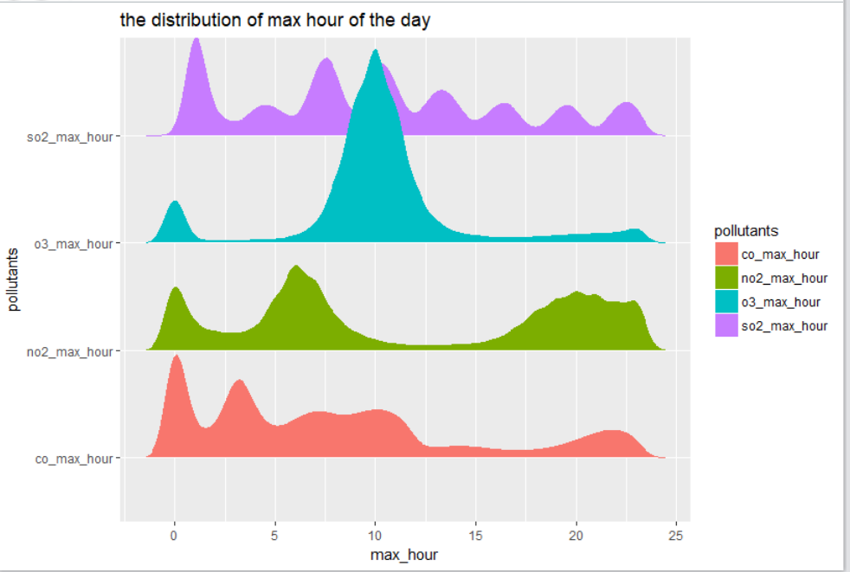
Check Distribution
Notes:
We also plotted the distritbution of max hour of four pollutants. Four pollutants show different fluctuation pattern during the day.

Slide 6
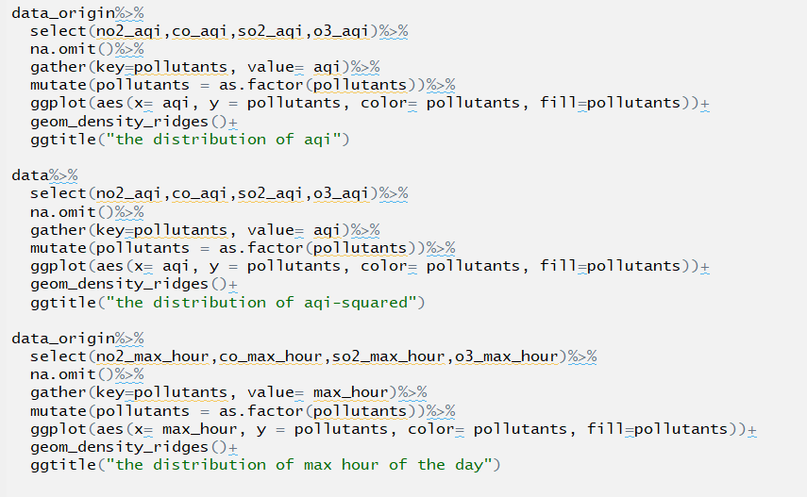
Code
ggridges
Notes:
This is my code for producing three plots, essentially, i used geom_density_ridges() function in ggridges package. This is a more compact way of showing distributions together

Slide 7
Time Aspect
Change of AQI across states from 2010-2016. (boxplot & line plot)
Change of Categorized AQI in six years. (histogram & pie chart)

Slide 8
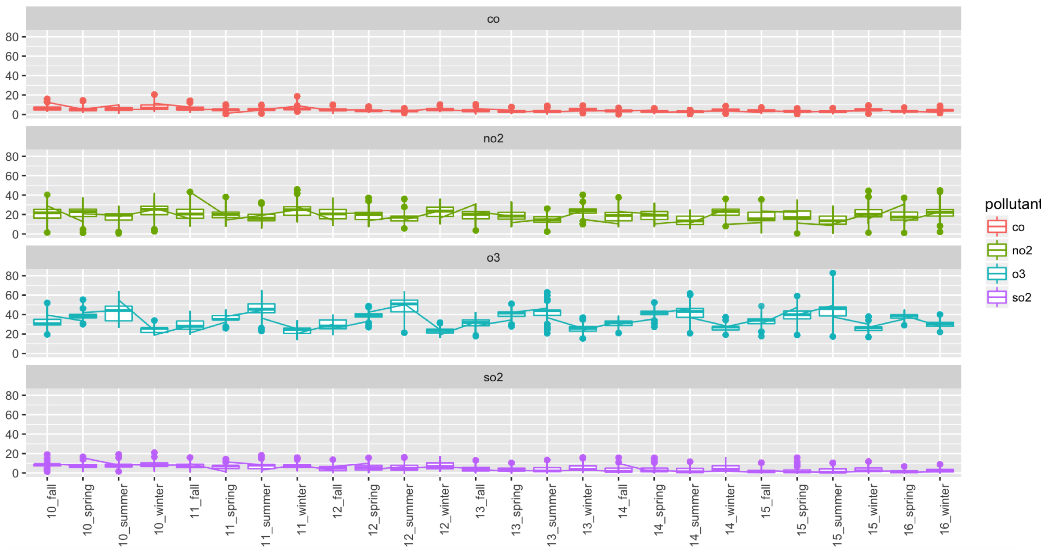
Change of AQI for all four pollutants
Notes:
Here, we made four parallel graphs showing the change of AQI for all four pollutants with the change of seasons for 6 years. We can see that seasonal fluctuations in each pollutant’s AQI. The most evident seasonal pattern is shown by the ozone’s aqi change. We can see that it reaches its peak at summer and then decreases until winter. This pattern confirms the fact that the increase of heat also cause the increase of ozone production. Other pollutants’ seasonal trends are not too significant.

Slide 9
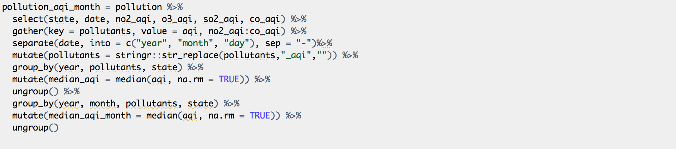
Code
Notes:
This is the code that I used to further extract the median of aqi across states per year and per pollutants. There are some functions that the red arrows point at. Separate function splits a single column into multiple columns by the dash line. Group by function group the data by categorical variables in order to calculate the median AQI. The unite function merges two variables into one.

Slide 10
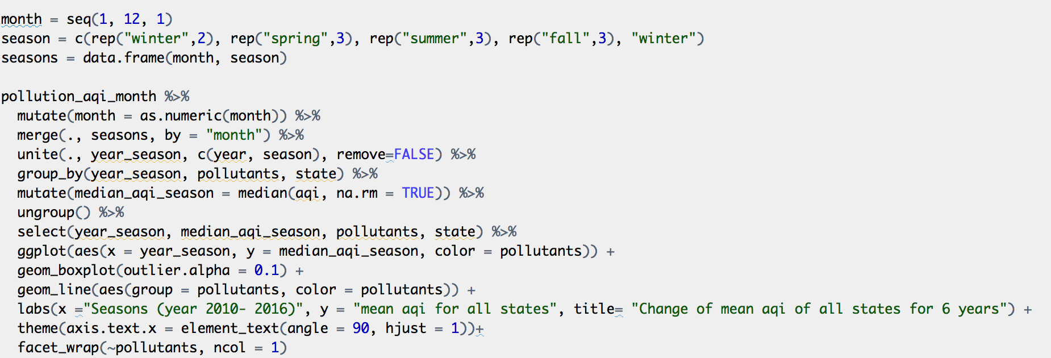
Code
Notes:
Merge function is to merge two data frames (datasets) horizontally; going back to our seasonal trend graph of the change of AQI, we were wondering whether the seasonal fluctuations in AQI will be more pronounced if we expand the x-axis, namely looking into each of the year.

Slide 11
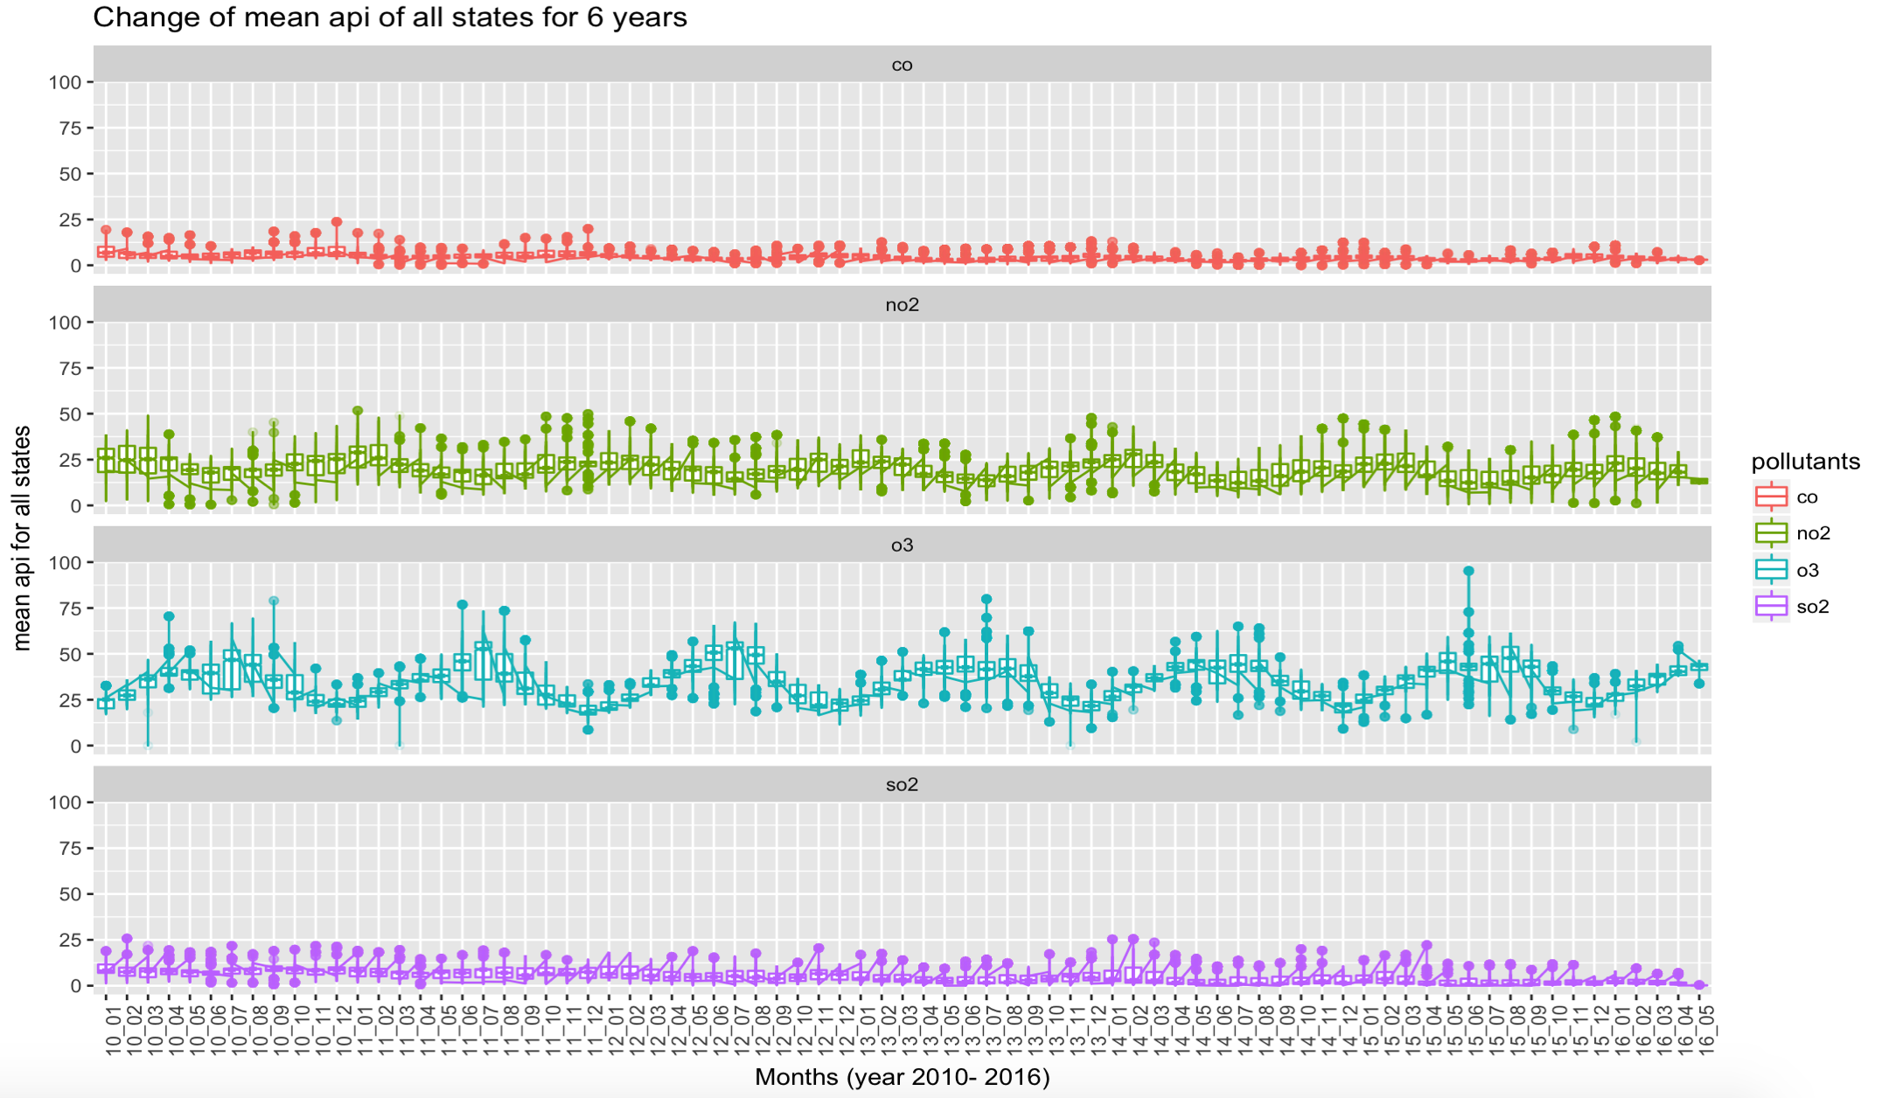
Change of AQI for all four pollutants
Notes:
We can see a little bit of the seasonal fluctuations in the change of no2 aqi, but it is not clear. Also, we can see a slight overall decreasing trend for the aqi for CO and SO2. But, again the trend is not evident when we look at each months data point across states.

Slide 12
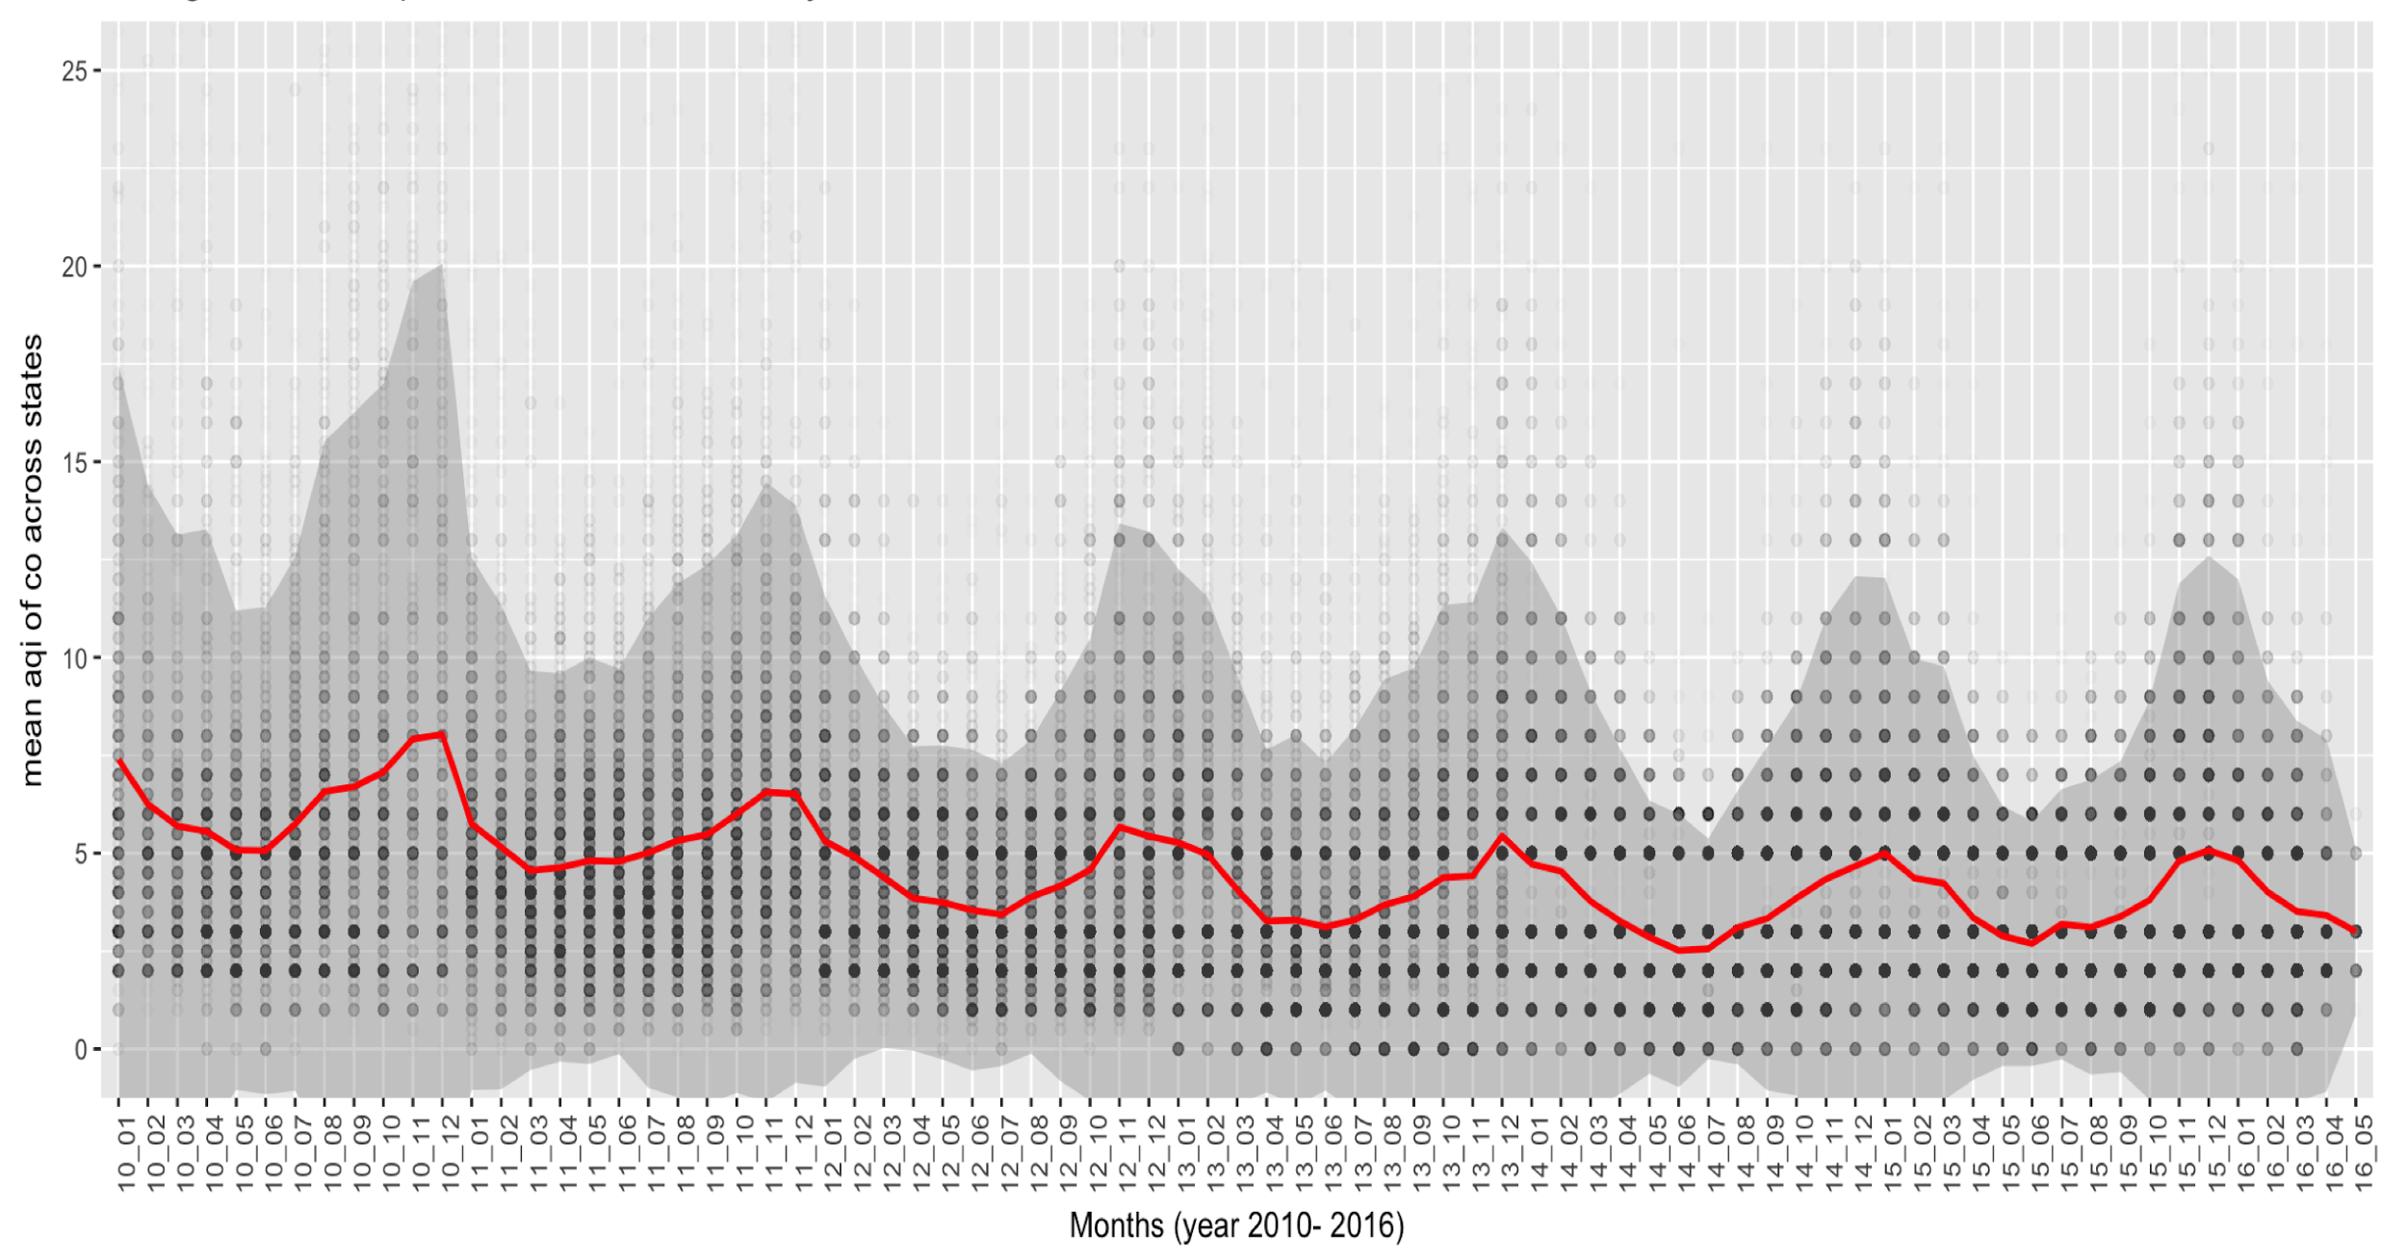
Change of AQI across states (CO)
Notes:
Dotted points are each state’s mean aqi for specific month, while the line connects the mean aqi across states. As we can see, the shaded area represents the standard error of the data of specific month. Due to the wide range of the sd, we can see that the data points varies across state. But in general, we can see a decreasing trend overall. And the seasonal fluctuation is visible suggesting that the aqi reaches its peak around november and decreases until march.

Slide 13
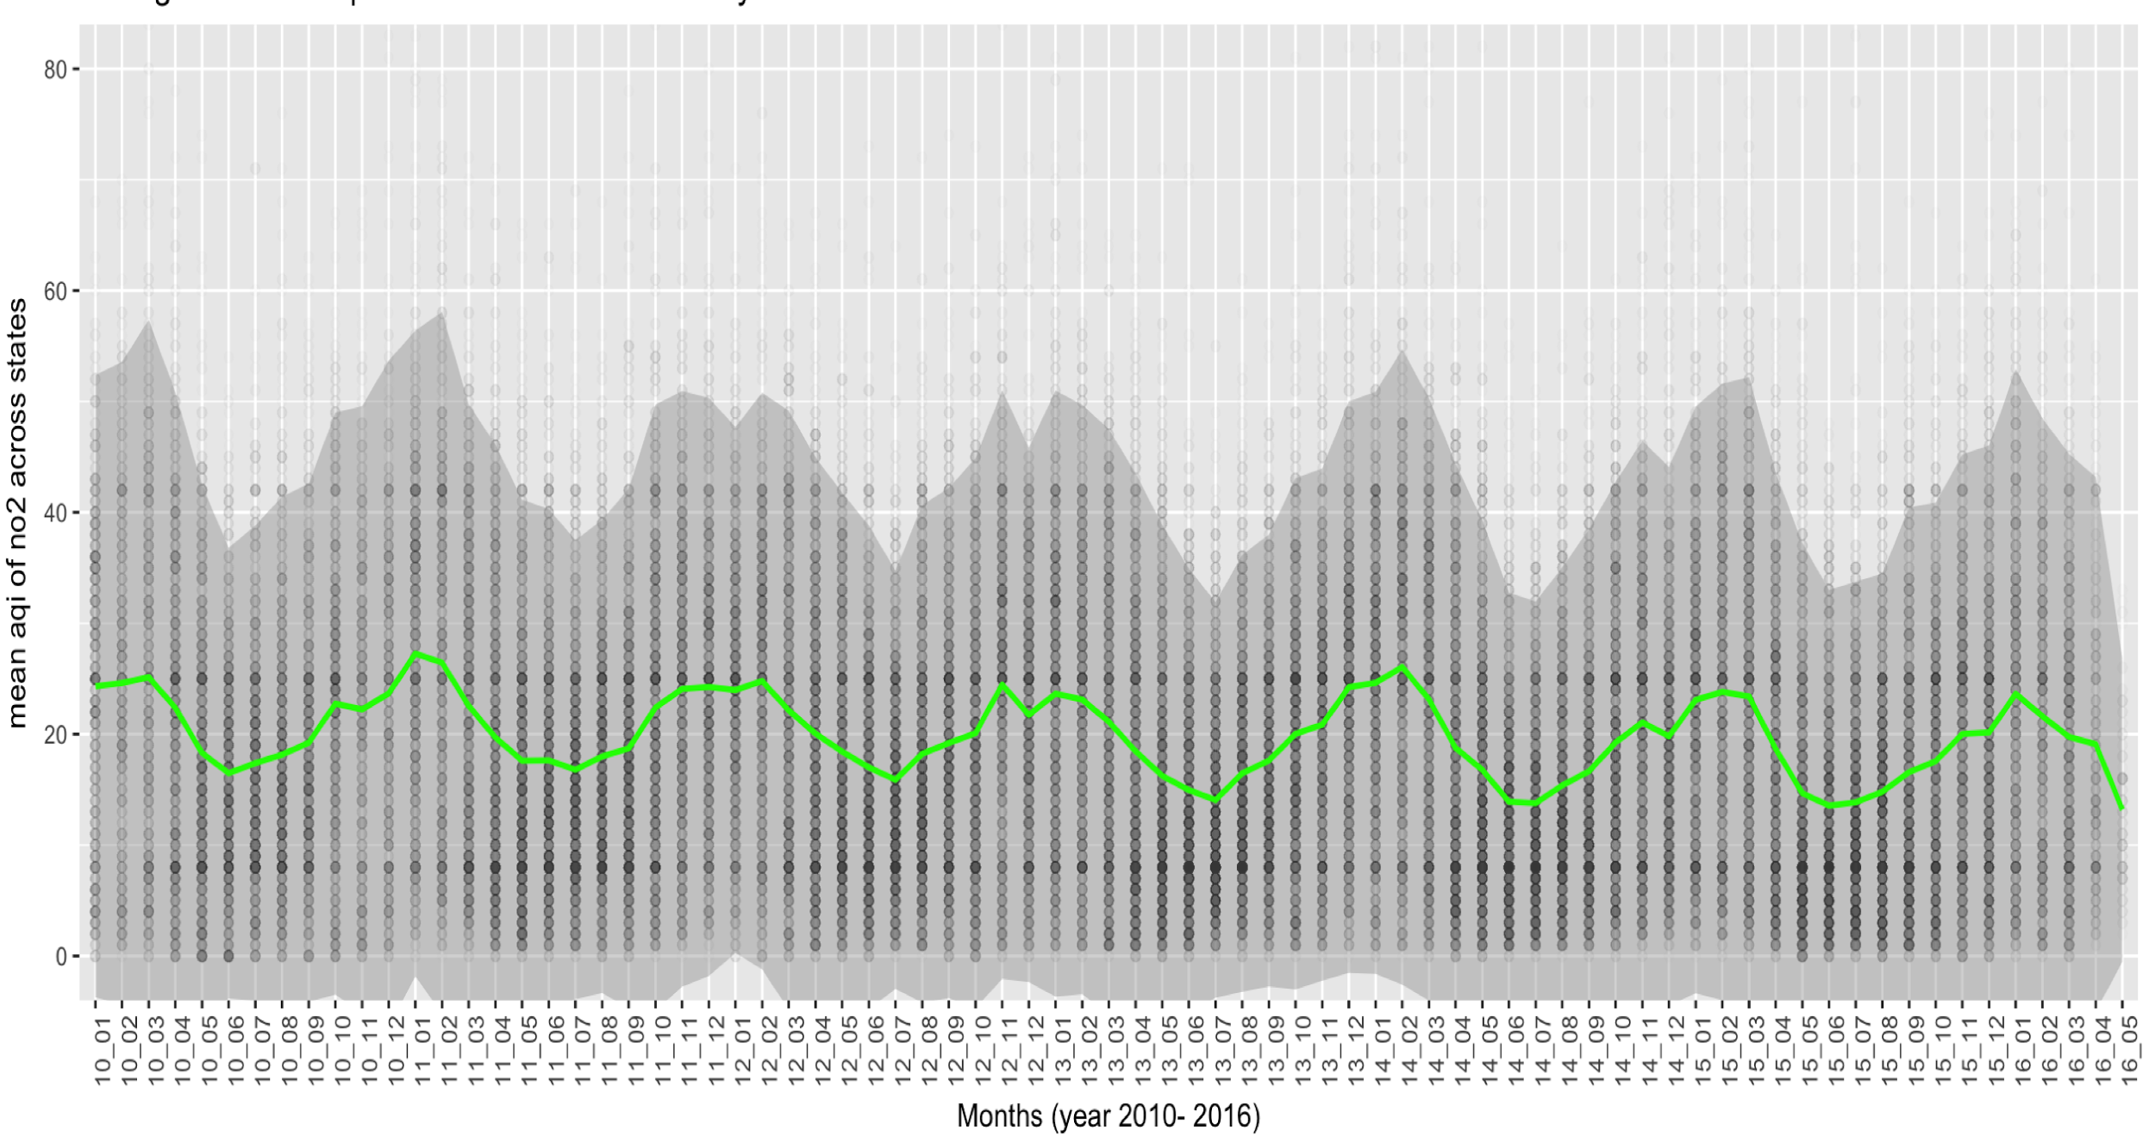
Change of AQI across states (CO)
Notes:
Slightly decreasing

Slide 14
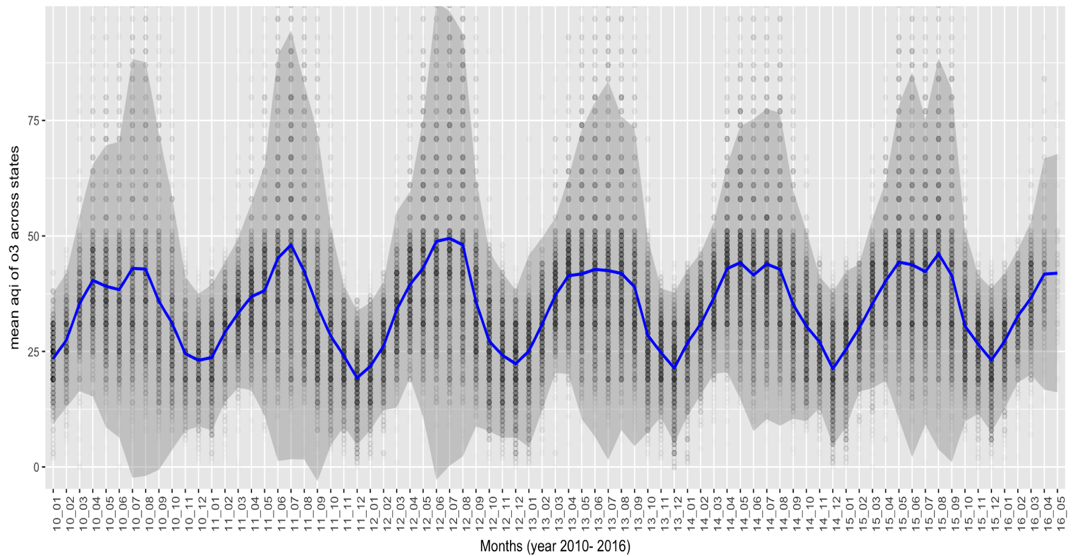
Change of AQI across states (O3)
Notes:
Seasonal fluctuation

Slide 15
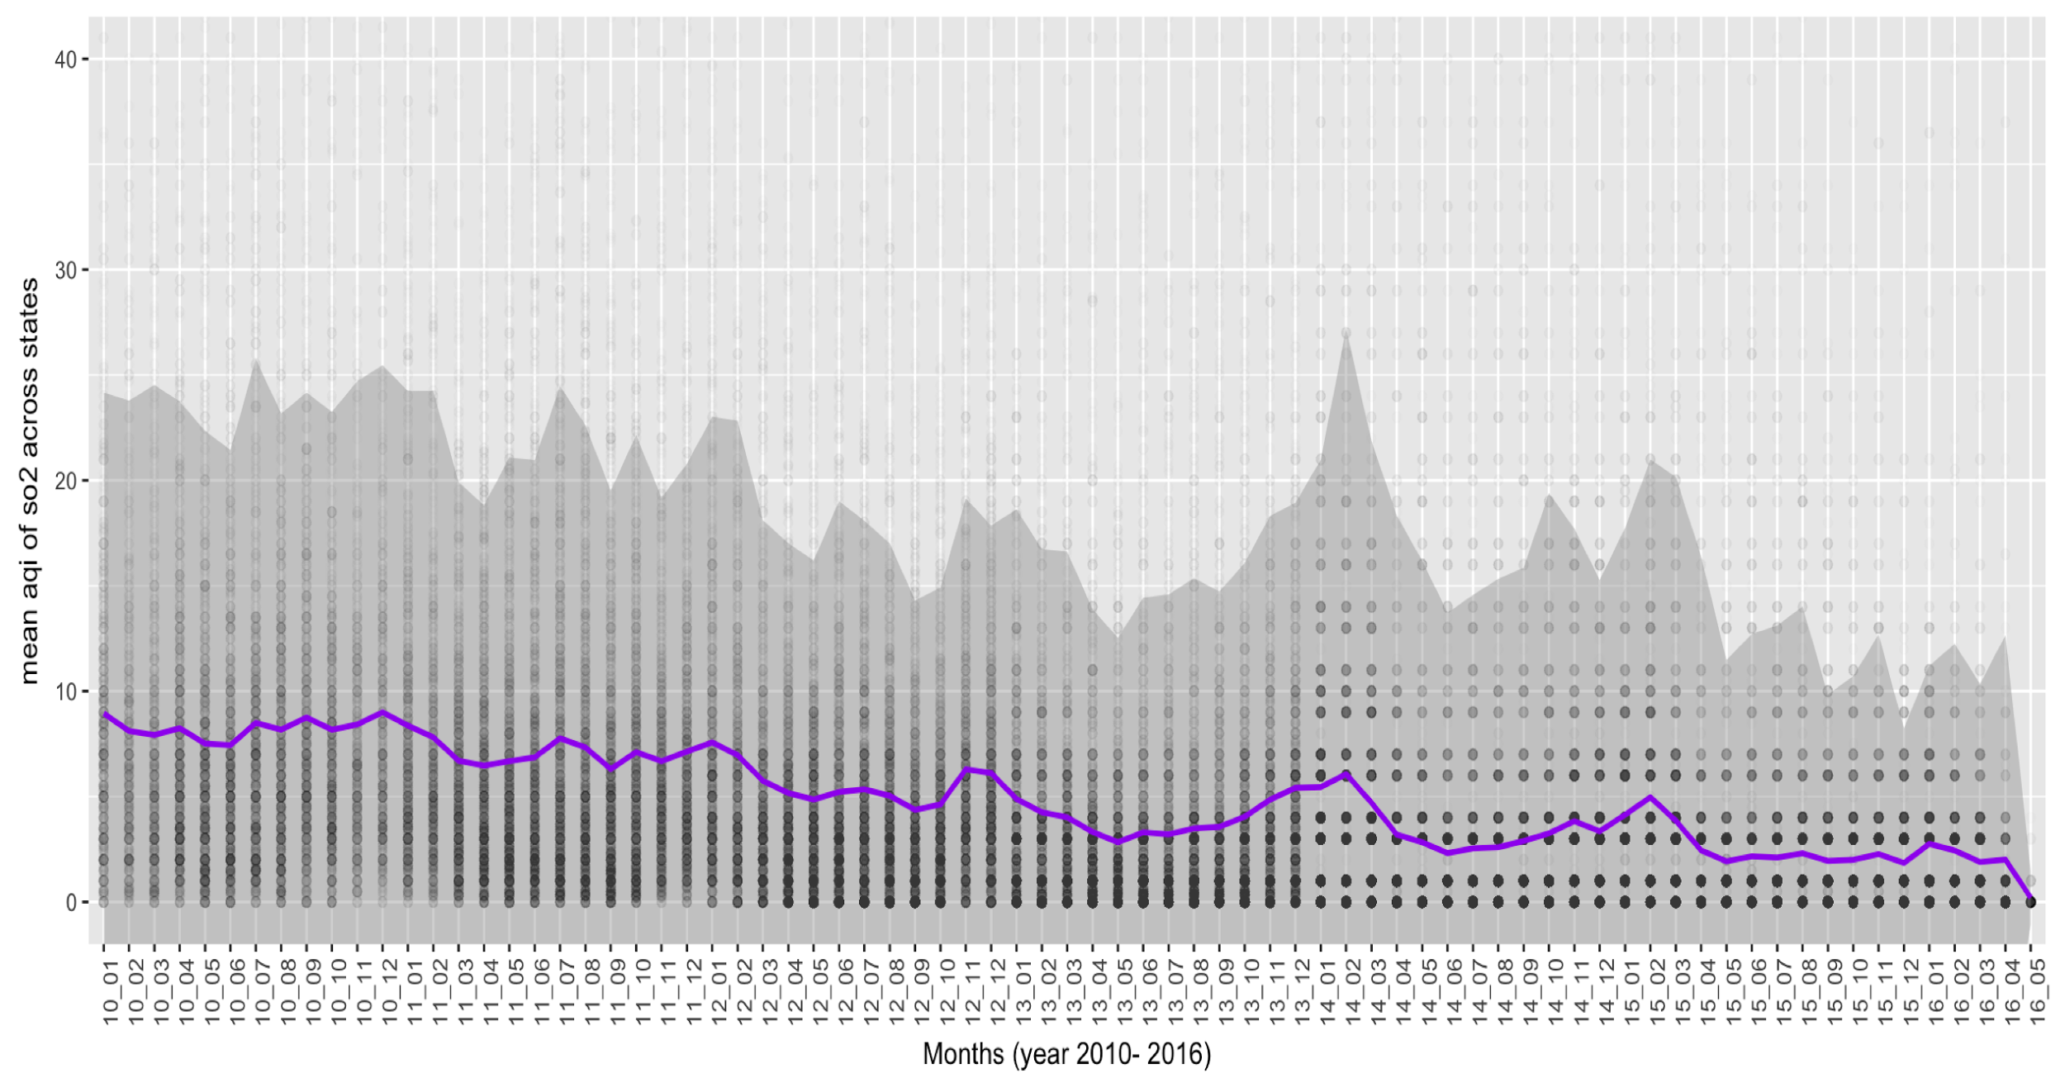
Change of AQI across states (SO2)
Notes:
Decreasing trend

Slide 16
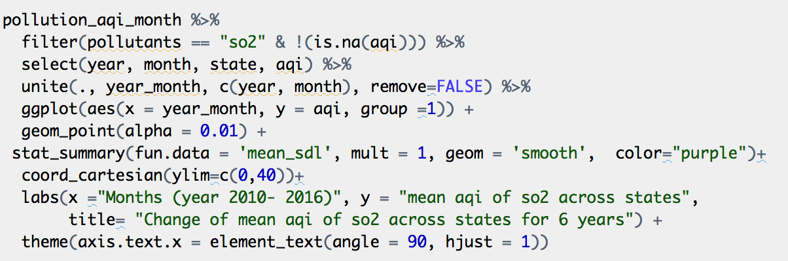
Code
Notes:
stat_summary allows for tremendous flexibilty in the specification of summary functions. The summary function can either supply individual summary functions for each of y, ymin and ymax (with fun.y, fun.ymax, fun.ymin), or return a data frame containing any number of aesthetics with fun.data. The 'mean_sdl' is an implementation of the Hmisc package's function 's mean.sdl' and the mult-variable gives how many standard deviations (above and below the mean) are displayed.

Slide 17
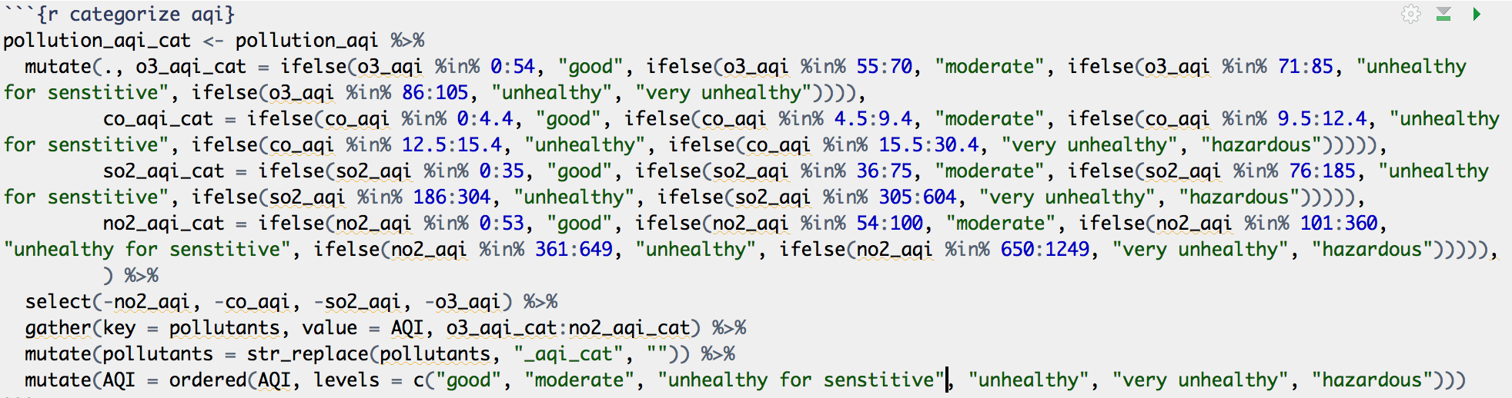
Variable Recode
Categorize AQI data into “Good”, “Moderate”, “Unhealthy for Sensitive Groups”, “Unhealthy”, “Very Unhealthy”, “Hazardous” based on United States Environmental Protection Agency (EPA).
Notes:
After visulizing the distribution between AQI and time, we would like to do some exploration between categorical AQI and time. Since EPA separate the range of each pollutants into different categories: good, moderate, unhealthy for sensitive, unhealthy, very unhealthy and hazardous. We mainly use ifelse condition here to recode aqi variables. Here, I use tidyverse and stringr package.

Slide 18
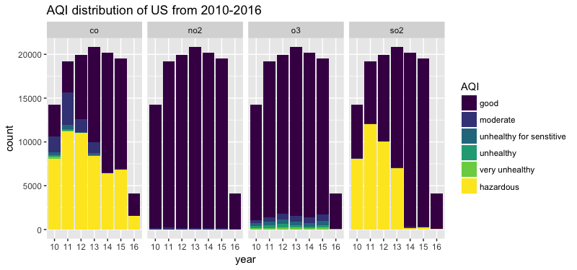
Categorized AQI distribution of US from 2010-2016
Notes:
In this bar charts, purple stands for good, dark blue for moderate, light blue for unhealthy for sensitive, dark green for unhealthy, light green for very unhealthy. And yellow for hazardous. For carbon monoxide, we can see that from 2010 -2016, year 2013, have the most counts for more than 20000. hazardous occupy almost ½. In the year 2010, hazardous almost takes up almost ⅔ of total count in year 2010.

Slide 19
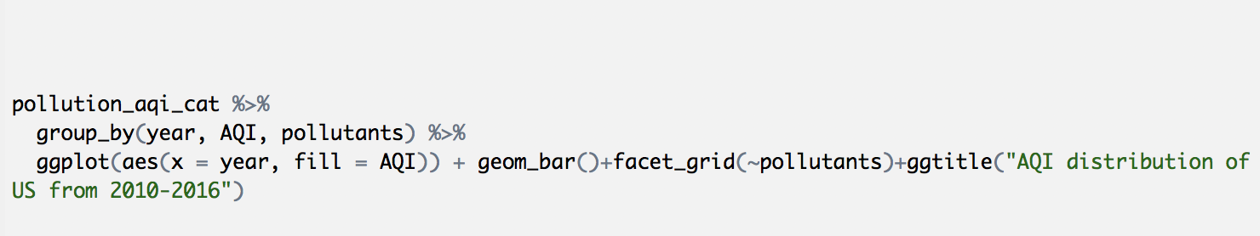
Code

Slide 20
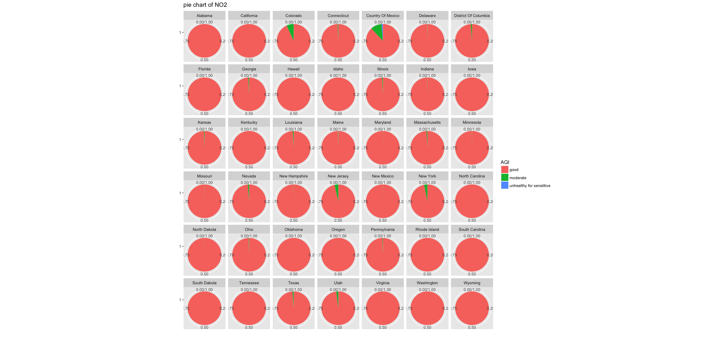
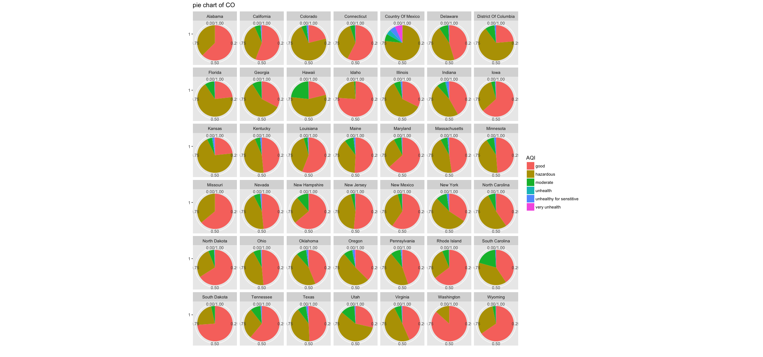
Pie Chart of categorized AQI across states (NO2, CO)

Slide 21
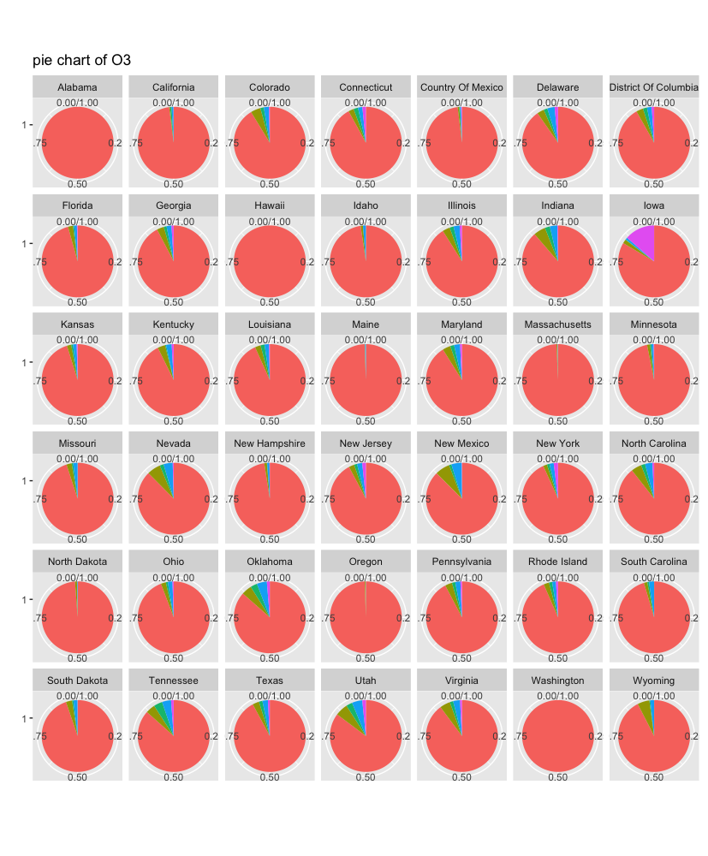
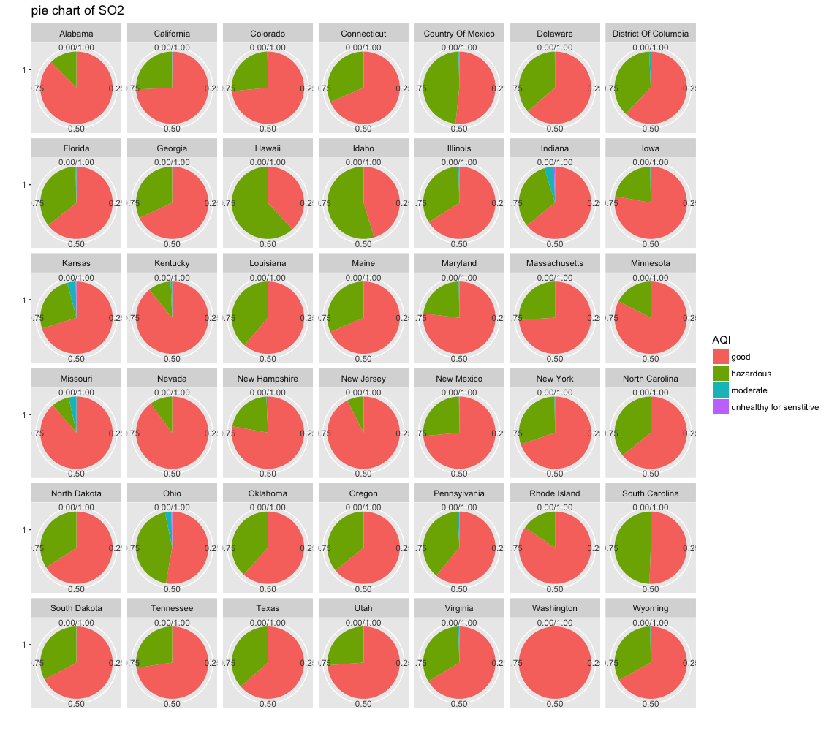
Pie Chart of categorized AQI across states (O3, SO2)

Slide 22
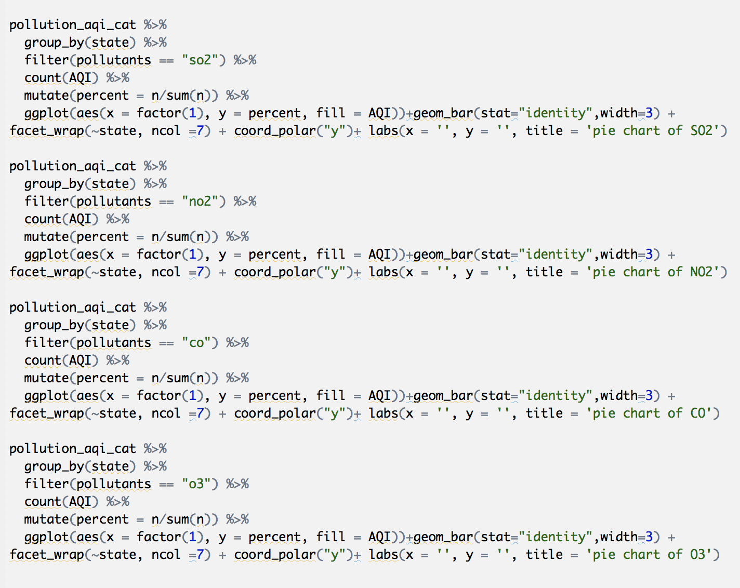
Code

Slide 23
Location Aspect
Pollutants AQI across states in six years. (boxplot)
Pollutants AQI across states in six years. (map & word cloud)

Slide 24
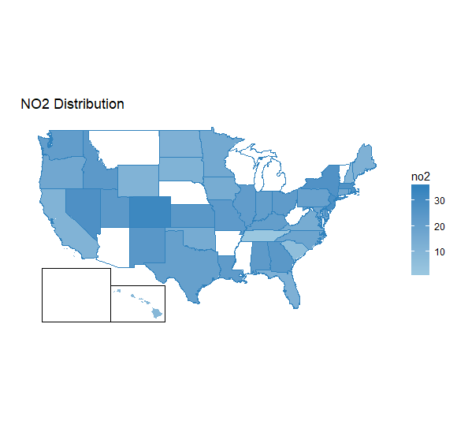
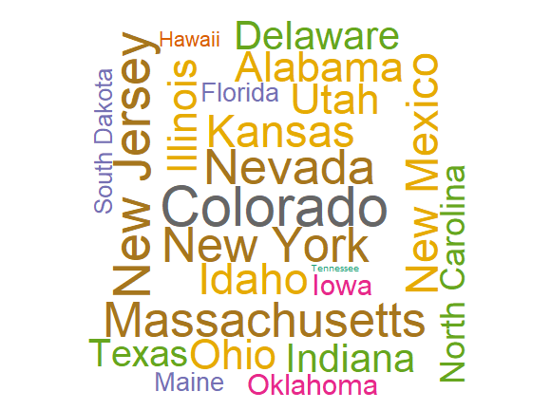
NO₂
Notes:
Here is the map and word cloud for NO2. For the map, deeper color represents higher average AQI and white part means related data is missing .As for the word cloud, larger words also means higher AQI here.

Slide 25
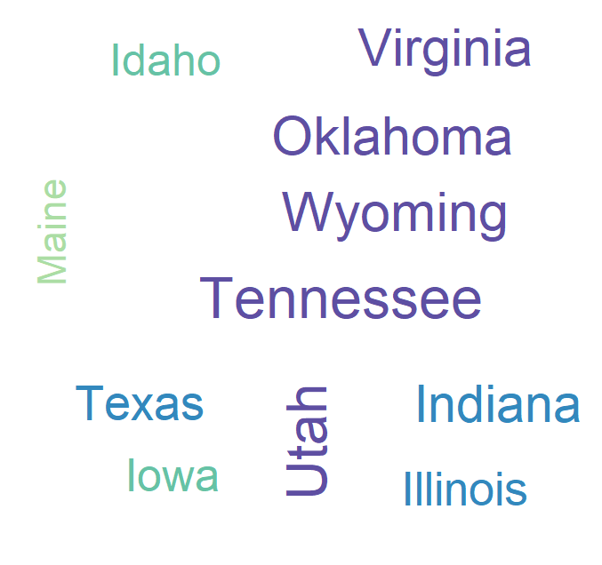
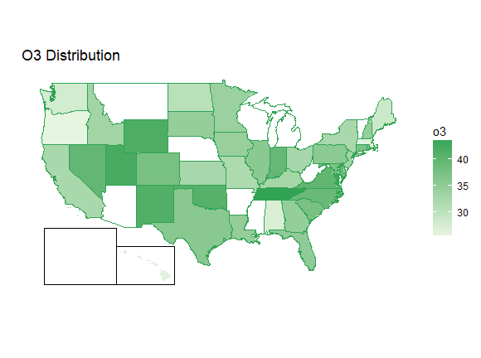
O₃
Notes:
From the word cloud for ozone, we could find that the national ozone distribution is quite uniform.

Slide 26
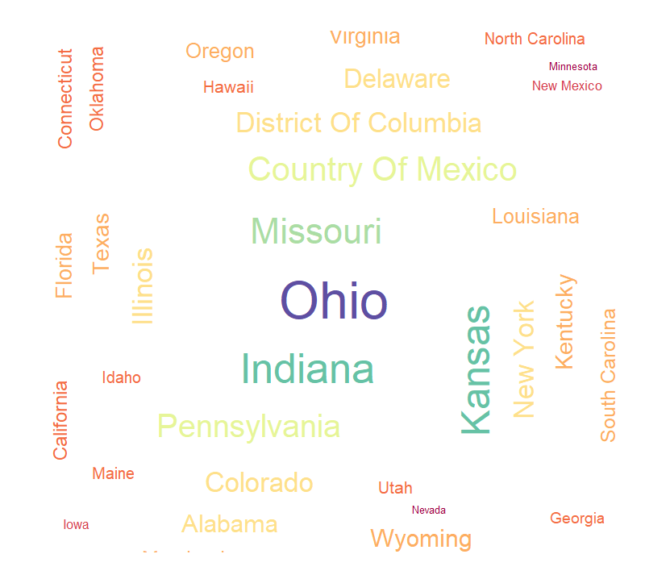
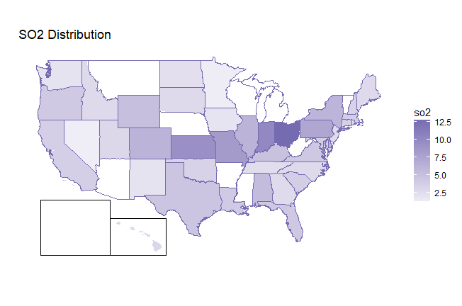
SO₂
Notes:
The similar situation occurs in the distribution of SO2.

Slide 27
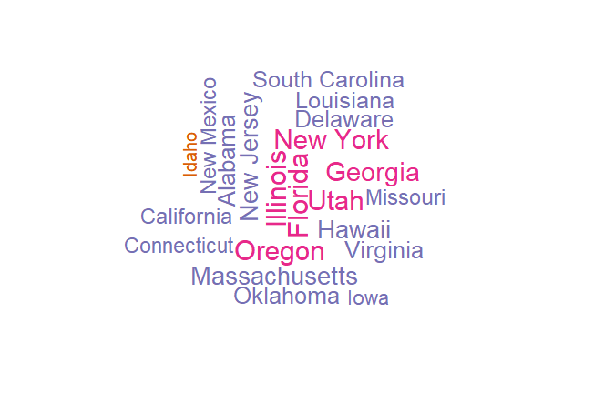
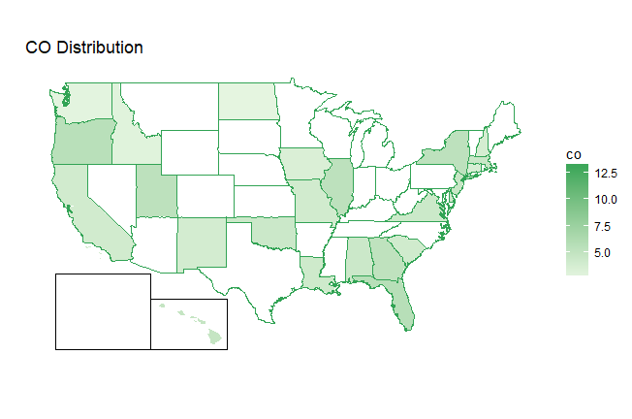
CO
Notes:
Here is the distribution of monoxide in the location scale.

Slide 28
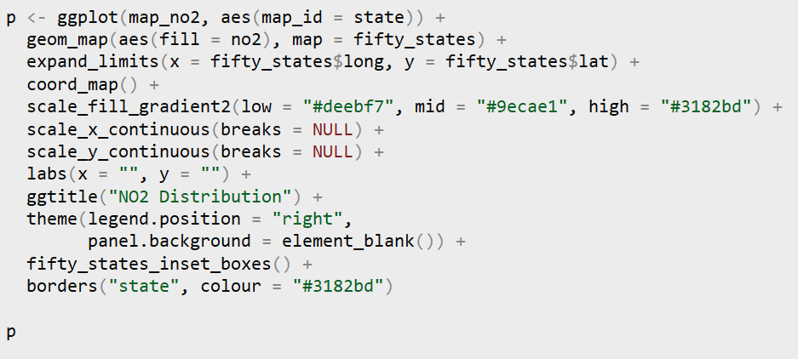
Map code
Notes:
I would like to introduce how could we make the map and word cloud. As for the map part, the package we wanted to mention here is “fiftystater” and “ggplot”. “Fiftystater” provide location information of states which could help us relate the location data with our pollutant data. I also want to mention is that, by default, lighter color would represent higher AQI in each state, which is quite anti-intuitive, that’s why we need to use the function “scale_fill_gradient2” to correct this part.

Slide 29
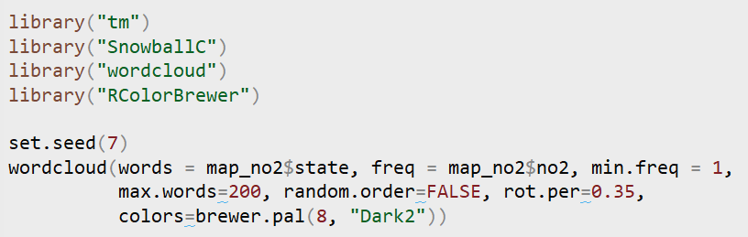
Word Cloud code
Notes:
As for the word cloud part. The most important package here is named “wordcloud”, and the methods are simple here. Larger word means higher frequency. The colour and the location of specific word are generated randomly, that’s why we have to set.seed here. It is worth mentioning that the word cloud is really useful when dealing with text, the packages we show here “tm” and “SnowballC” might be helpful here.

Slide 30
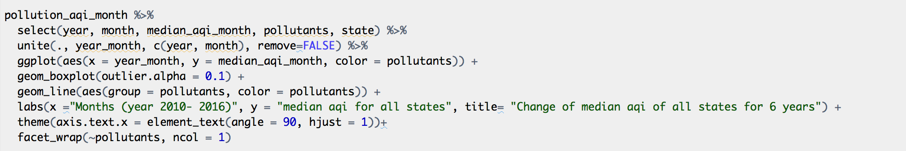
Code
Notes:
At this point, we want to explore more about whether there is truly decreasing trend for the two pollutants or it is a misunderstanding when we look at the data at a brader scale. So we plot each pollutants’ mean aqi and its standard error across states for 6 years. In this way, we can visualize the data better and have a better sense of the pattern and potential model that could be employed.

Slide 31
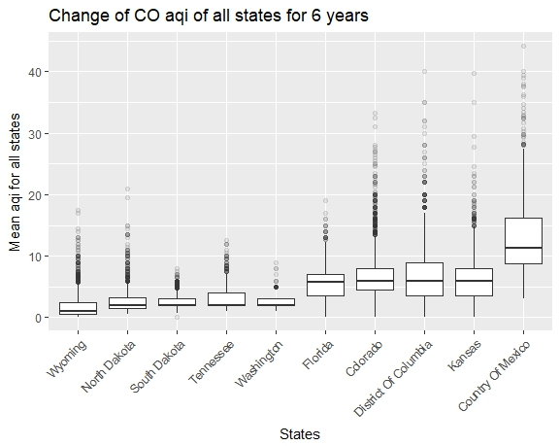
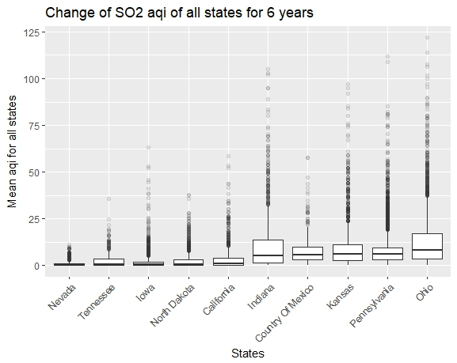
Pollutant Levels Across States
AQI for CO
AQI for SO2

Slide 32
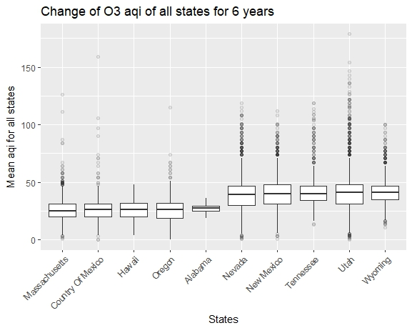
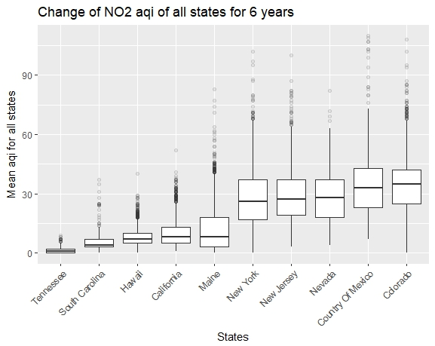
Pollutant Levels Across States
AQI for O3
AQI for NO2

Slide 33
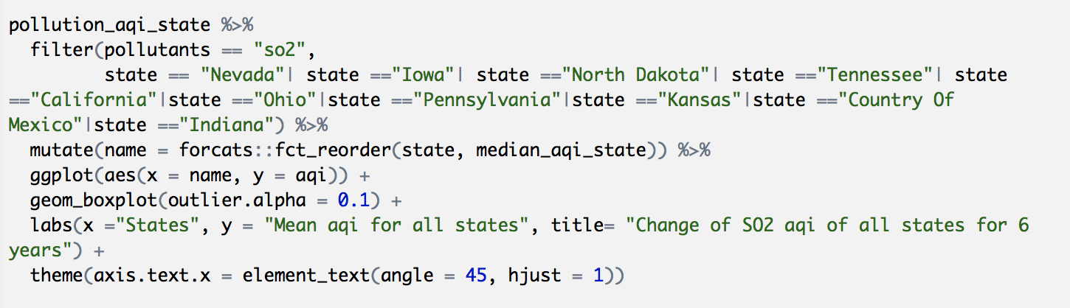
Code

Slide 34
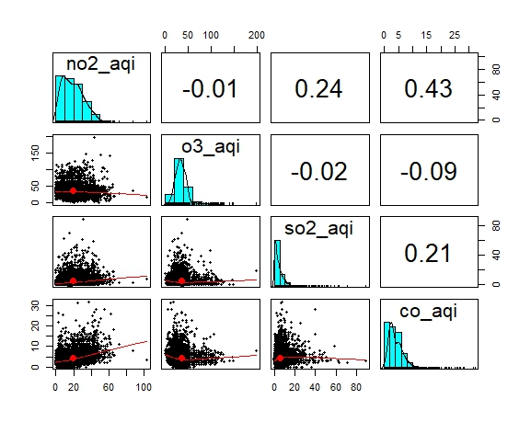
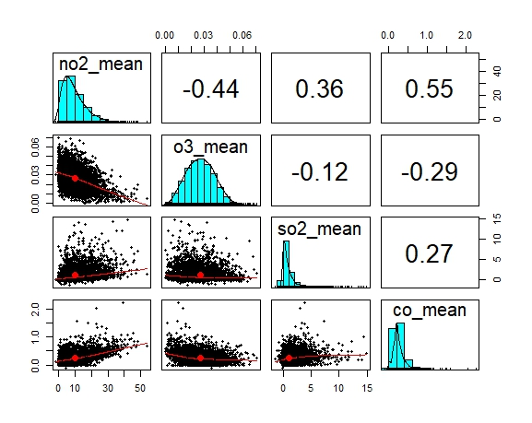
Variables Correlation

Slide 35
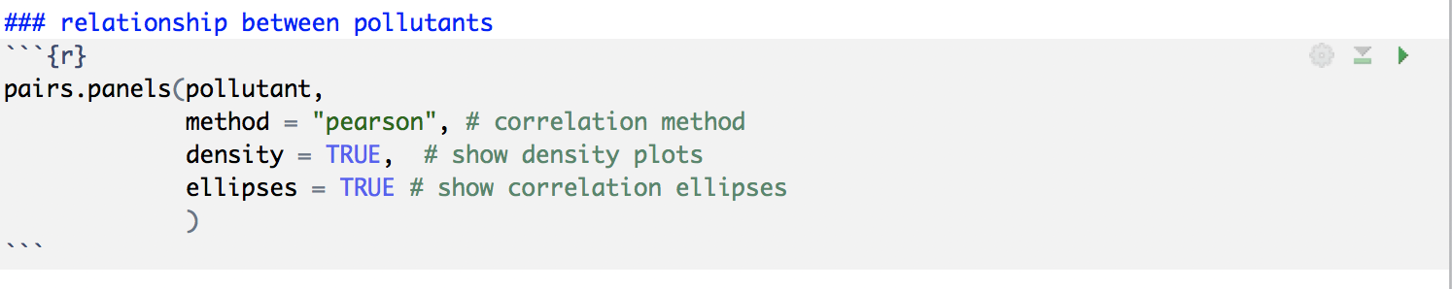
Code

Slide 36
Discussion:
Distributions of pollutants are not normal, reminding us that if we need to fit models based on normality assumption, data transformation is needed.
Periodic trends are observed in all pollutants, specifically for NO₂ and O₃, indicating that pollutants value relate with the time. Further predictive model could be time-dependent.
Decreasing trends are inspected in NO₂, SO₂ and CO. Further statistics tests should be addressed to verify this tendency.
The distribution of pollutants in most states is similar, which implies that a national model might be available to predict pollution situations in each state.

